Slide 1

Sales Analysis Dashboard
Tableau project

Slide 2
Description
Problem Statement:
DigiComp is a global enterprise that, among other things, caters to designing, developing, manufacturing and marketing products like - clothing materials.
DigiComp has expanded its presence across the globe, and the business wants to get an in-depth analysis of its sales so as to make better sales decisions. So, DigiComp has decided to use Tableau Dashboards to consolidate the data from multiple sources, and carry out the sales analysis. This will help the sales department to access the data from remote locations that would increase the overall timeliness, find inefficiencies, and make better decisions.
As a Tableau developer, I was tasked with creating an interactive Sales Dashboard in Tableau for the Sales department to use it for ad-hoc analysis and reporting.

Slide 3
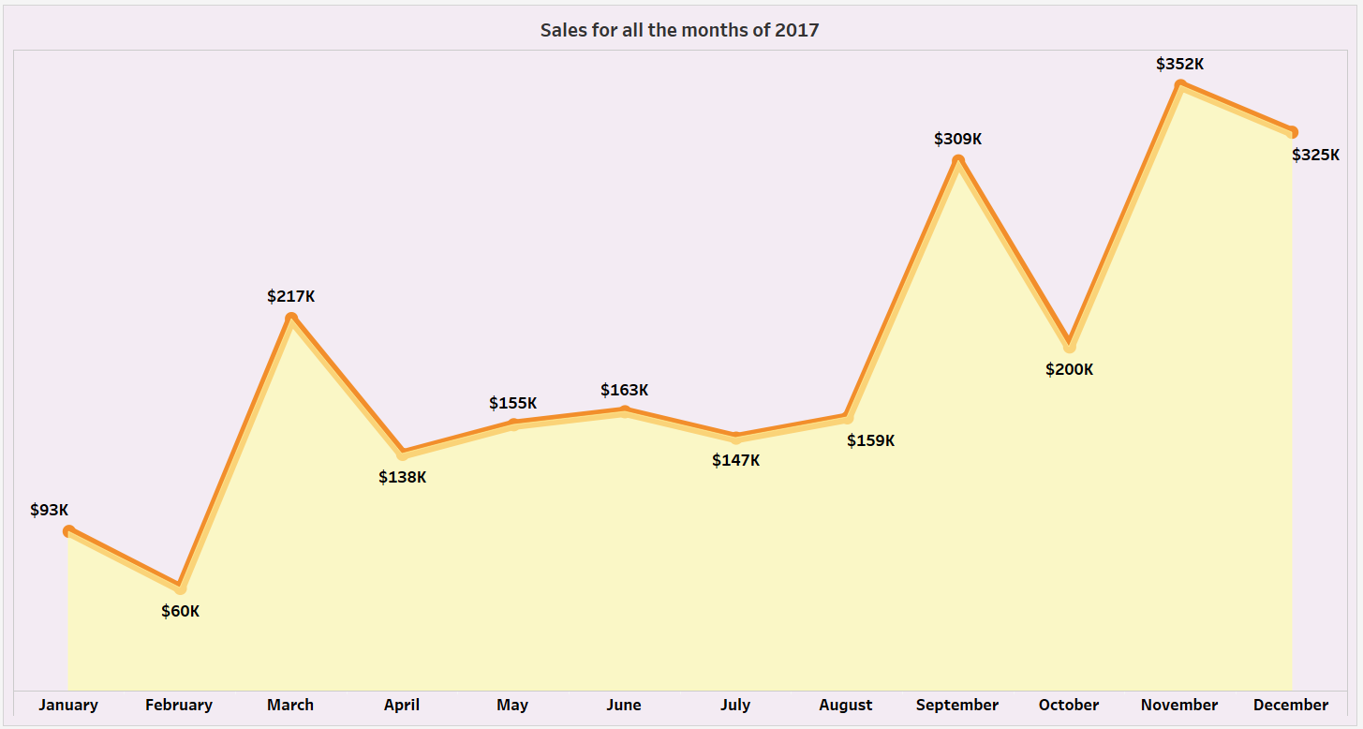

Slide 4
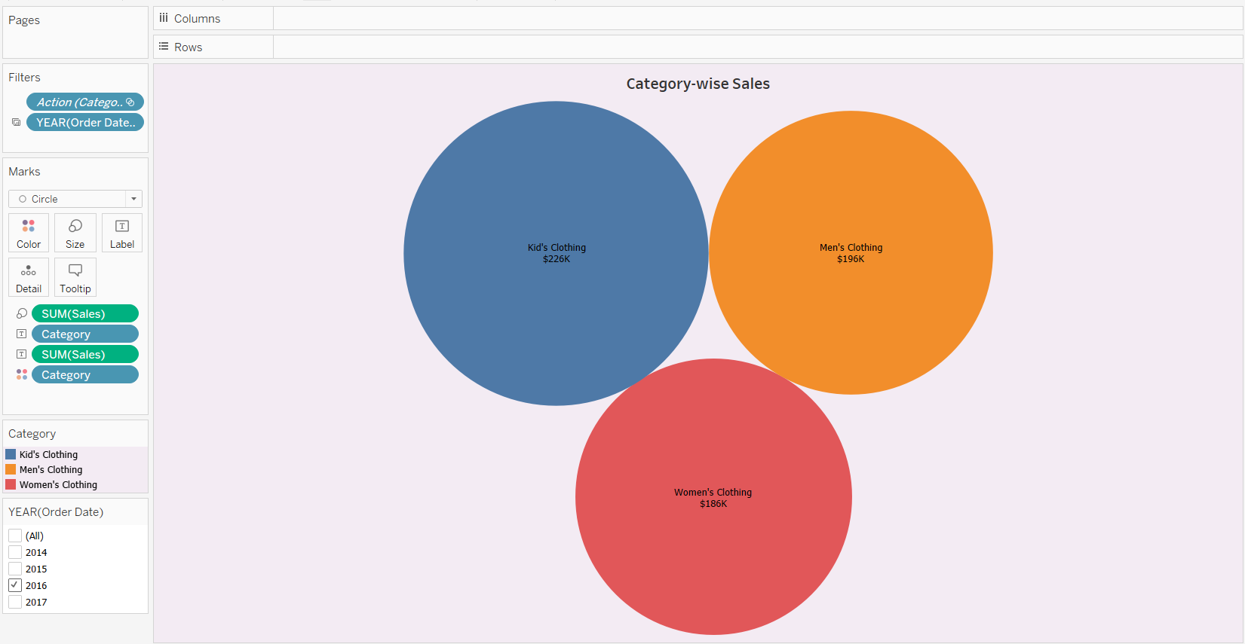

Slide 5
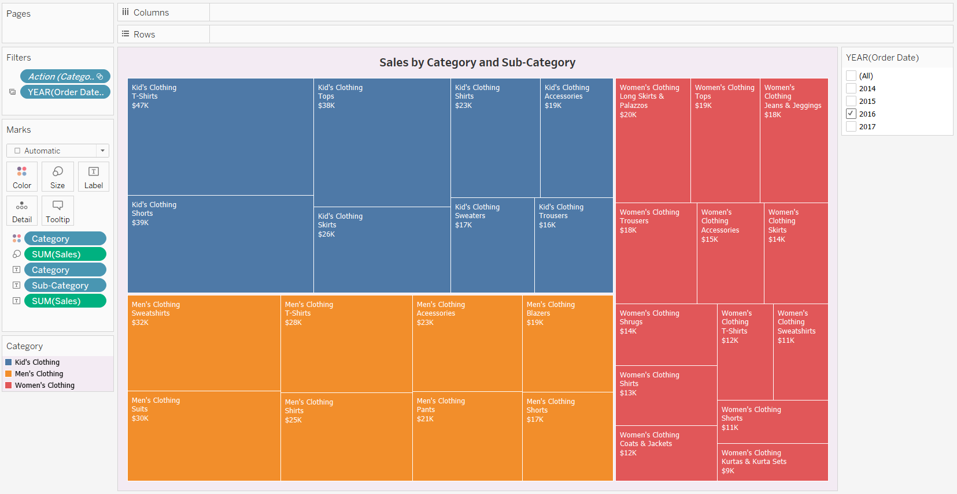

Slide 6
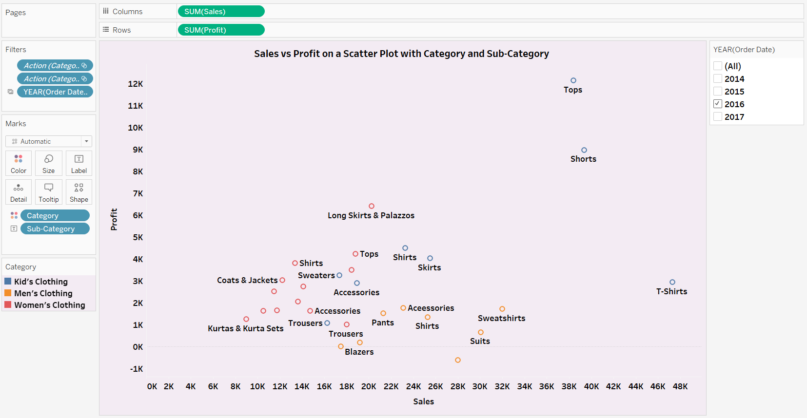

Slide 7
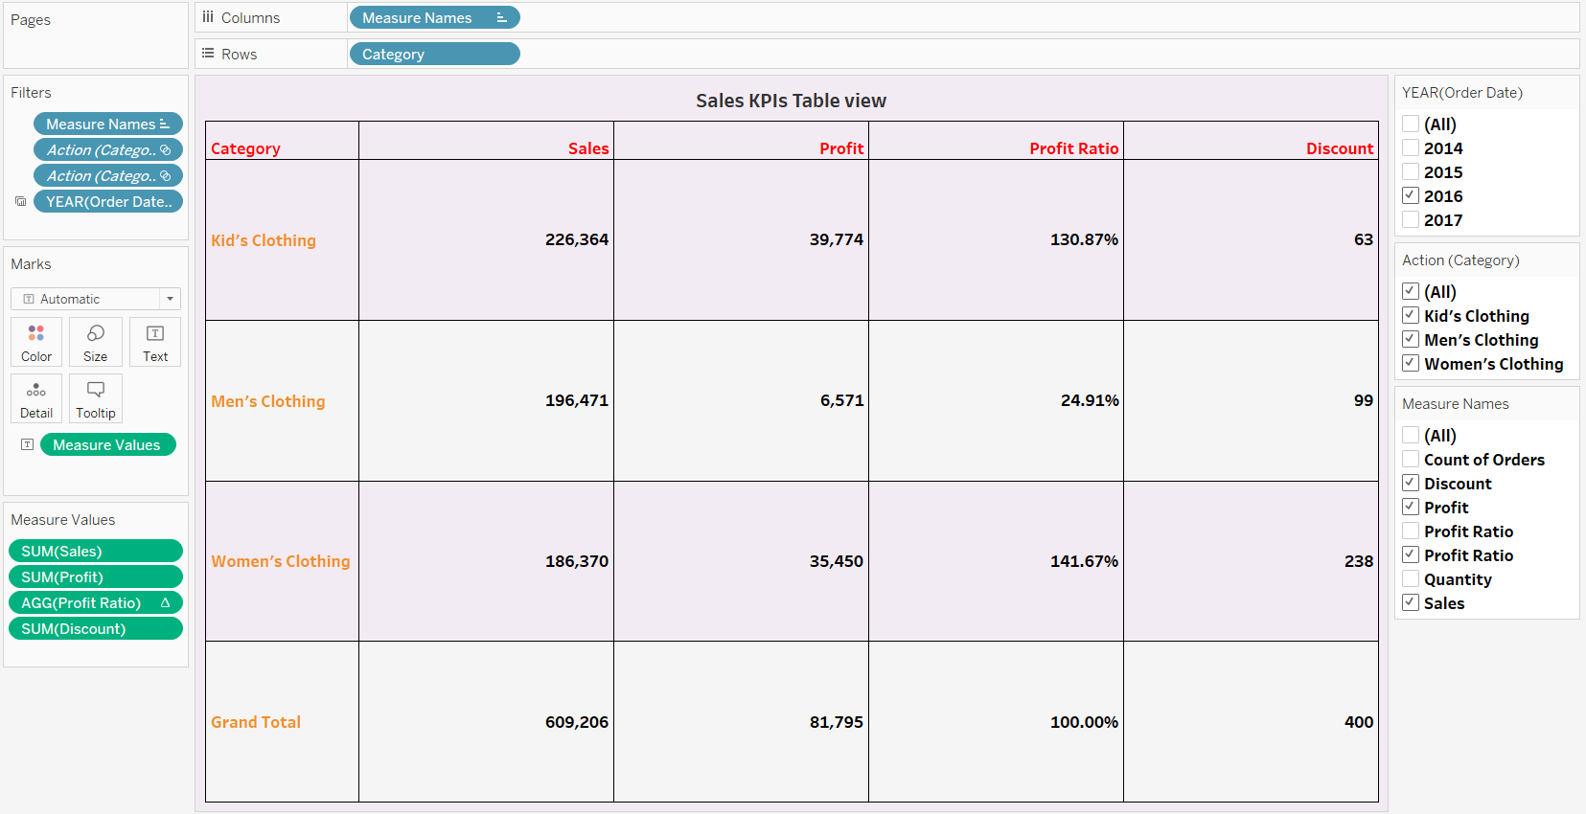

Slide 8
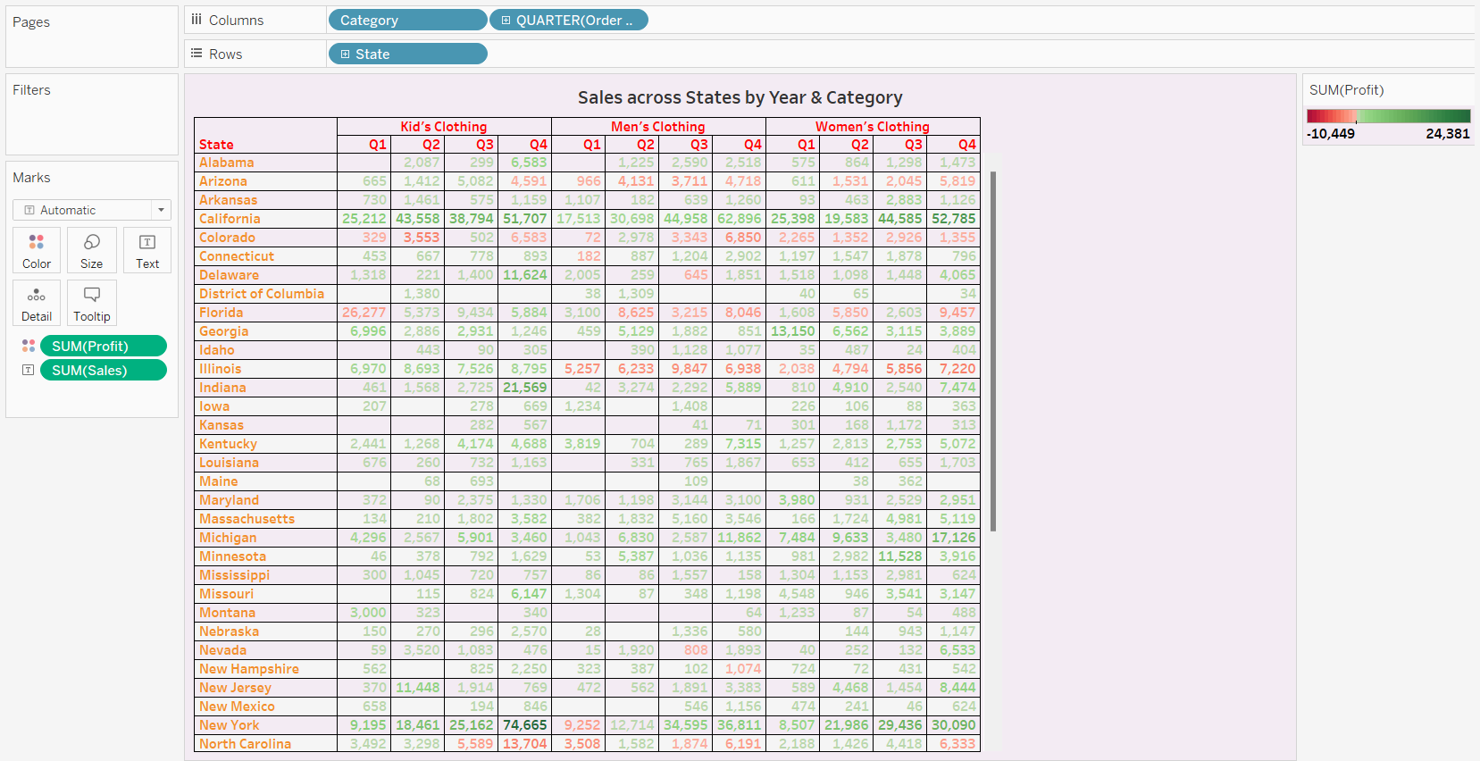

Slide 9
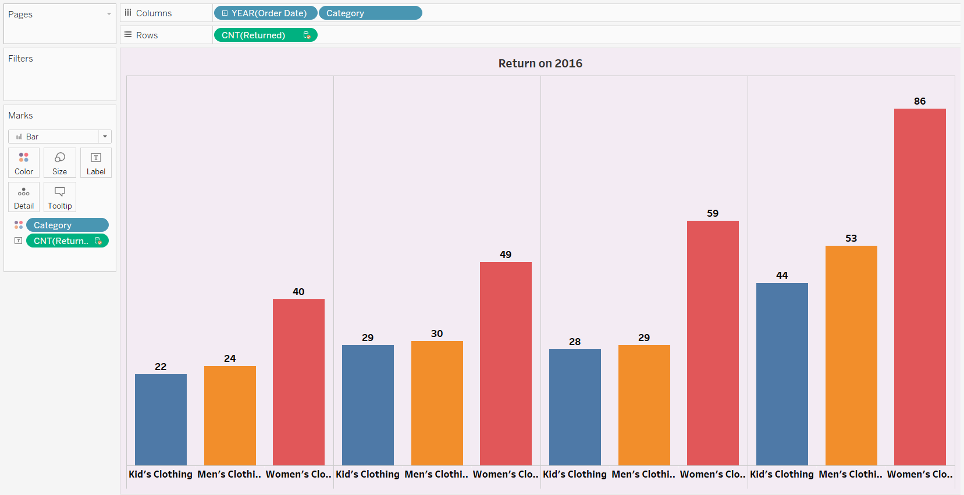

Slide 10
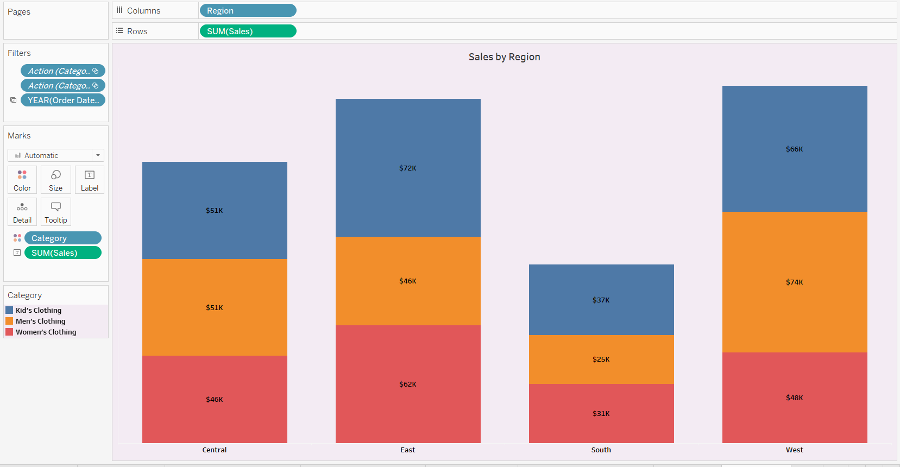

Slide 11
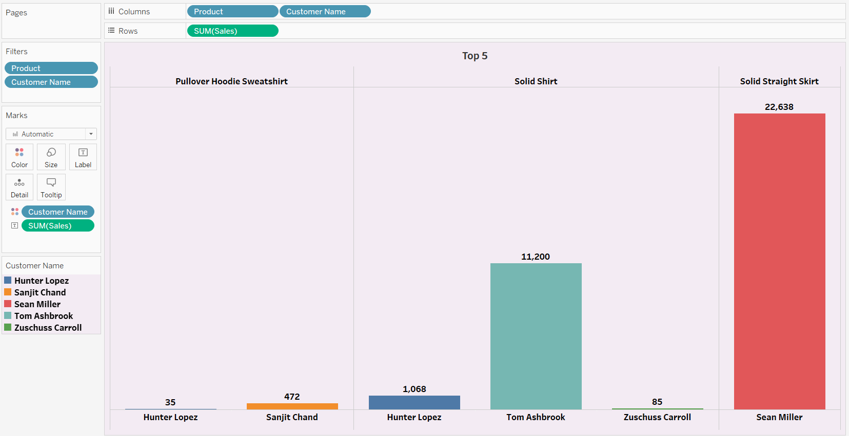

Slide 12
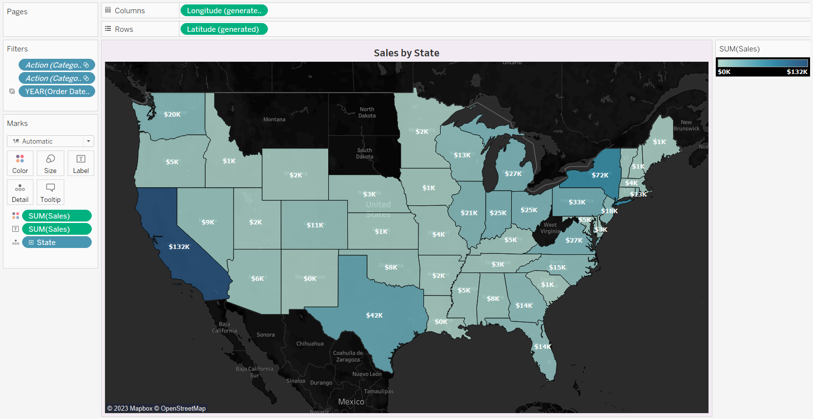

Slide 13
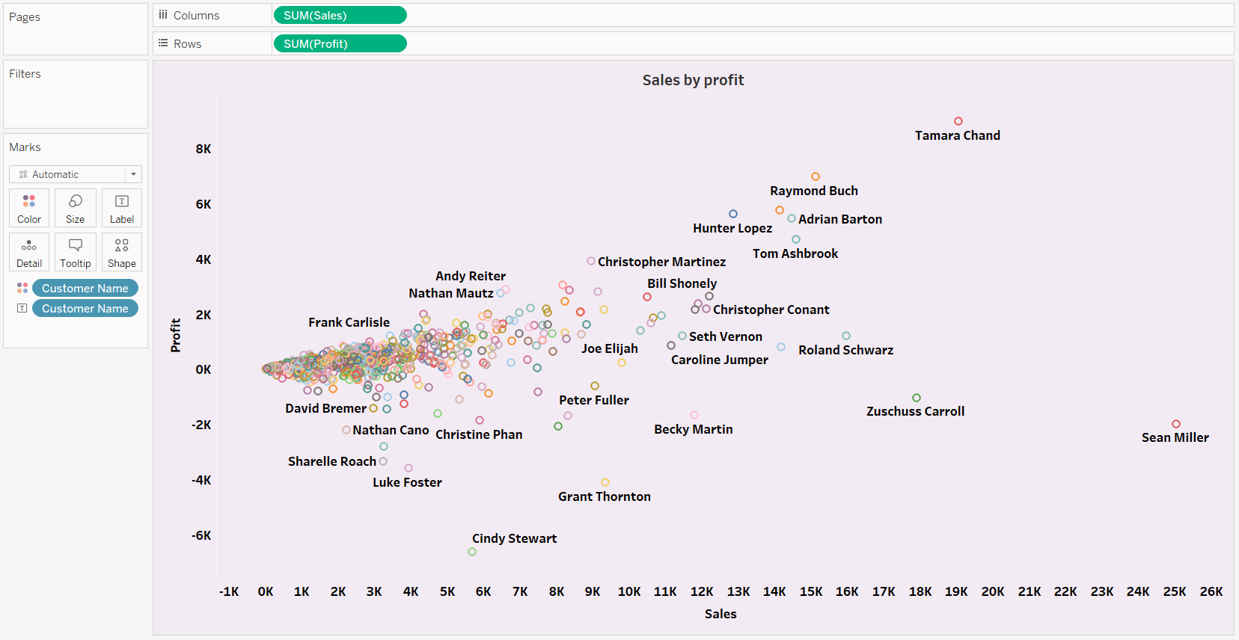

Slide 14
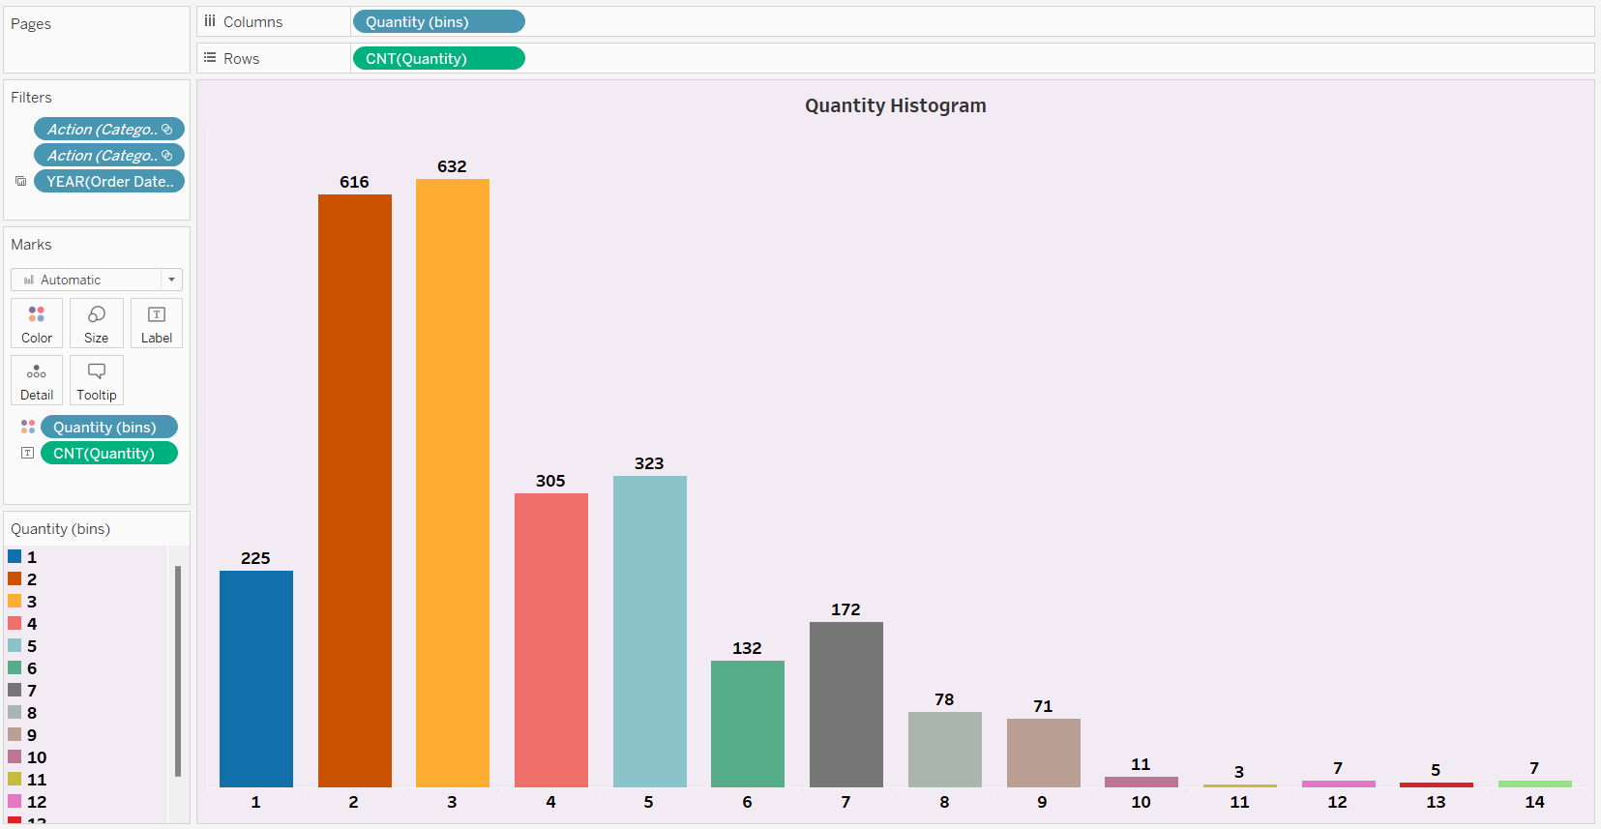

Slide 15
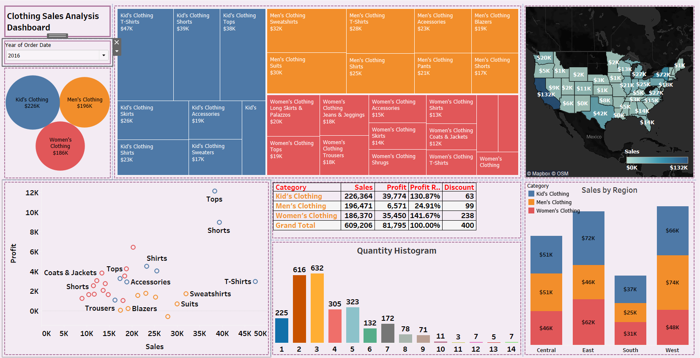

Slide 16
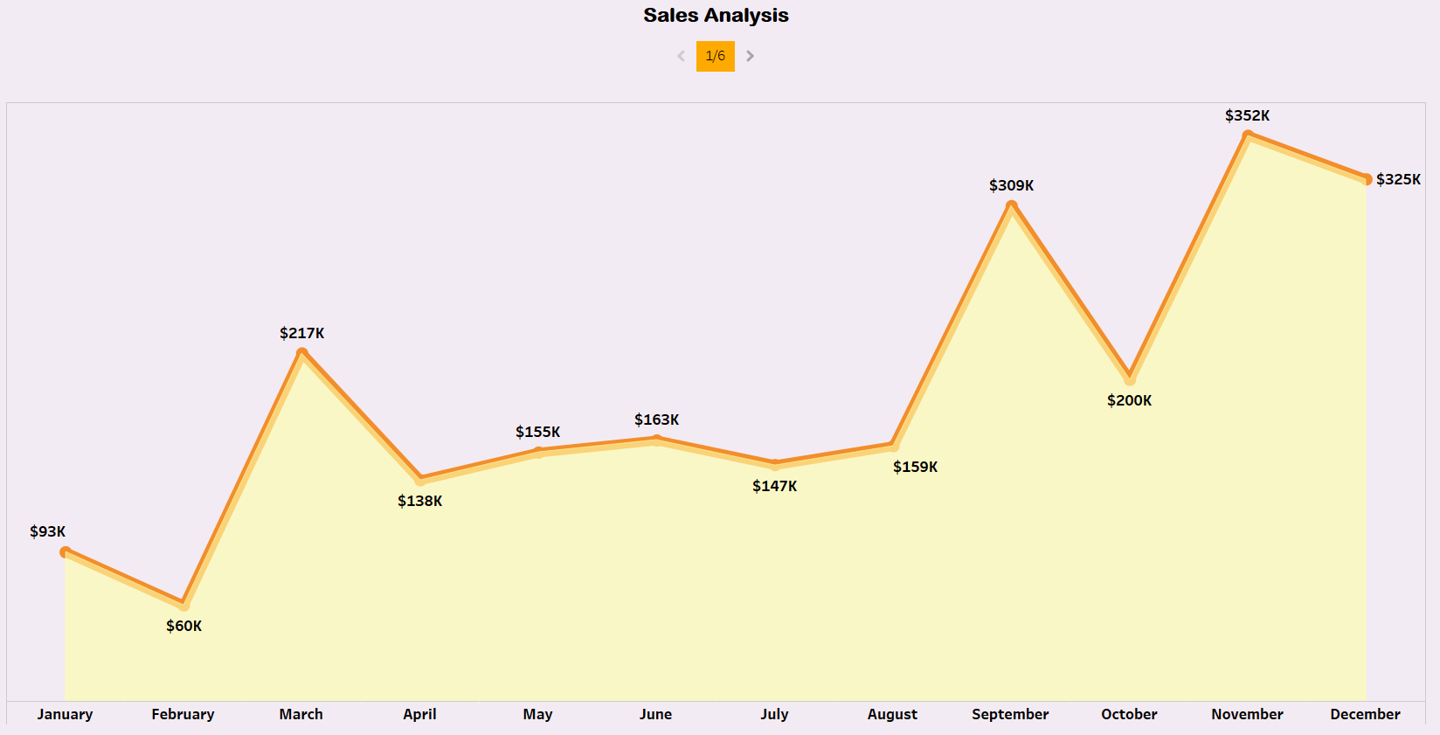

Slide 17
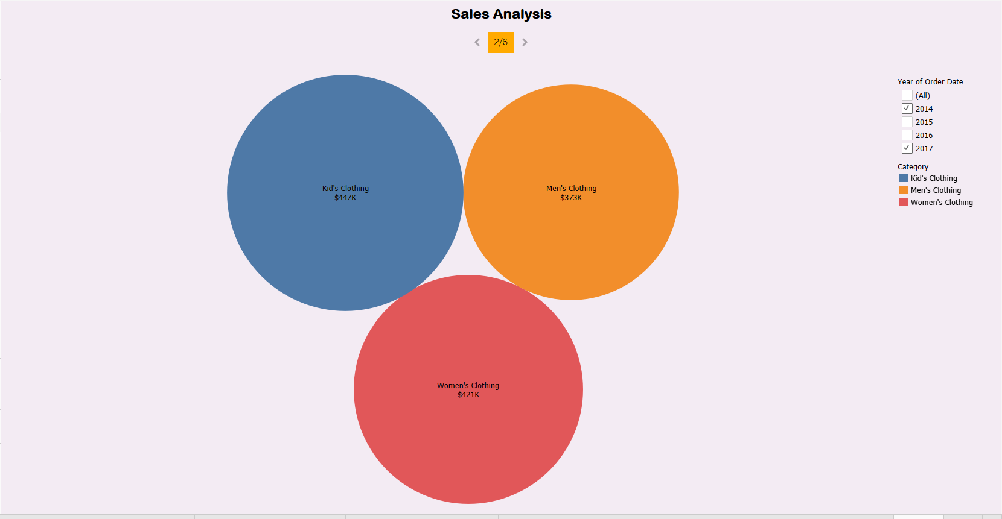

Slide 18
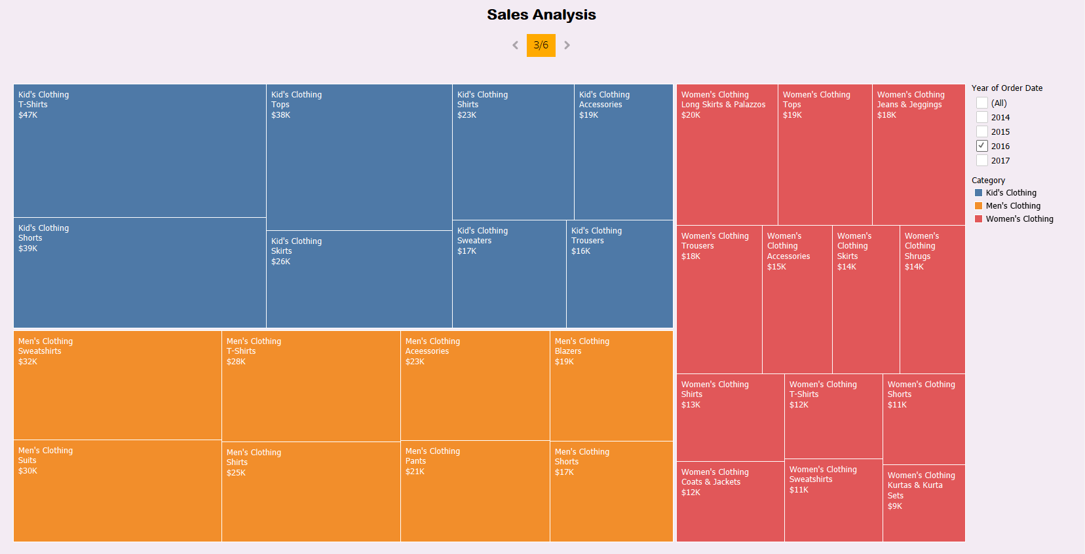

Slide 19
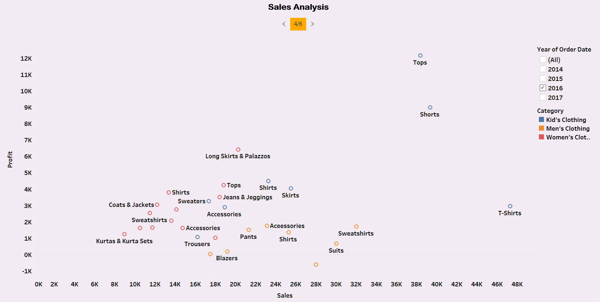

Slide 20
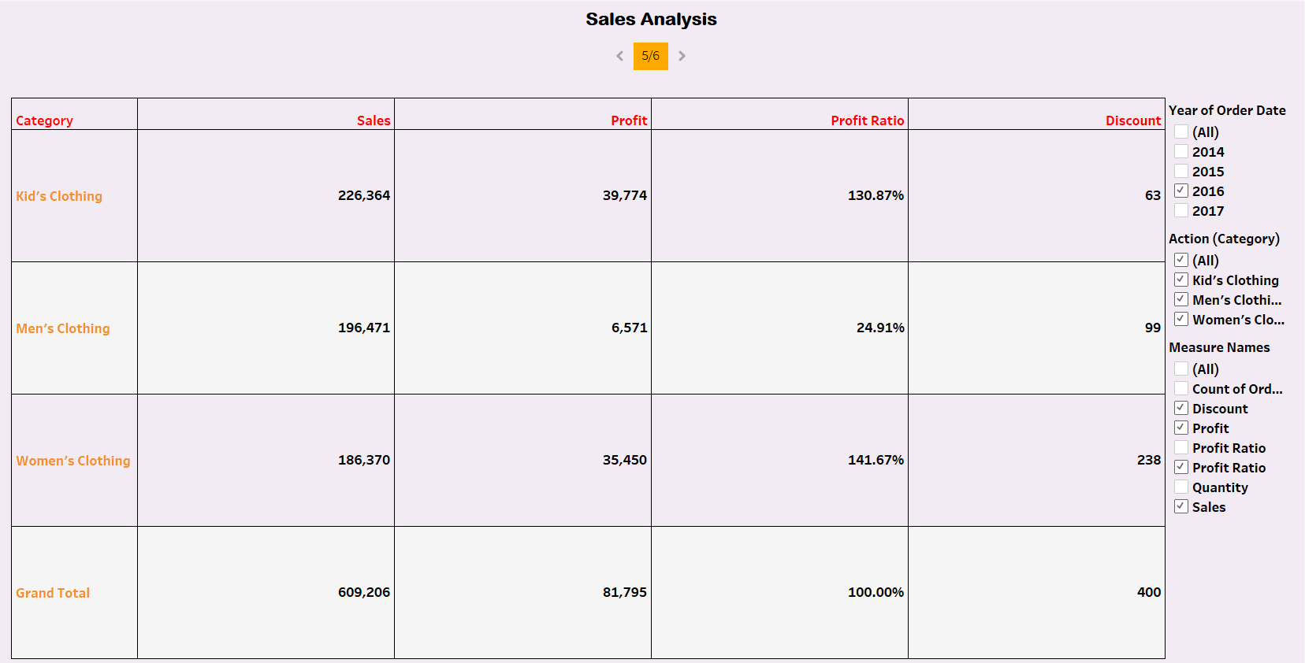

Slide 21
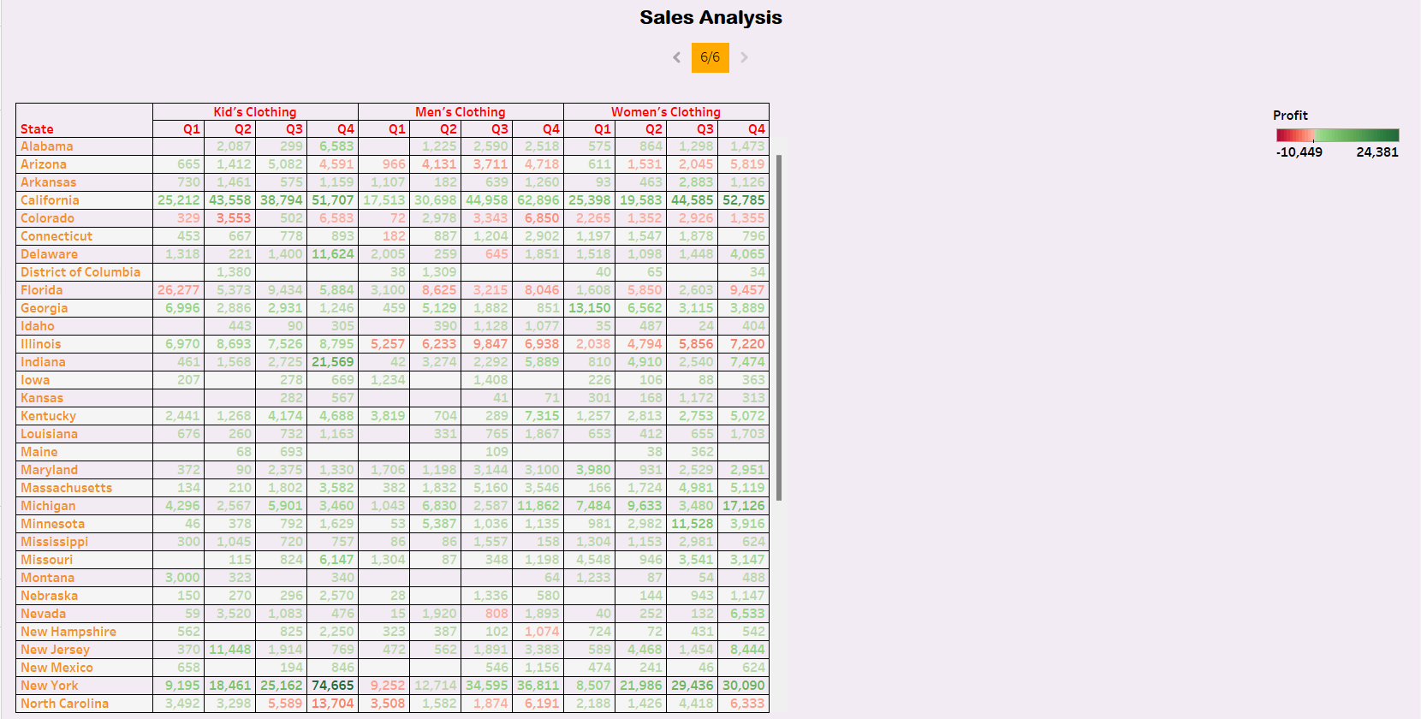

Slide 22
Thank you

